Slide 1
COMP6705001 Distributed Systems
Introduction to Distributed System Course
Session 1
Ardimas Andi Purwita
ardimas.purwita@binus.edu

Slide 2
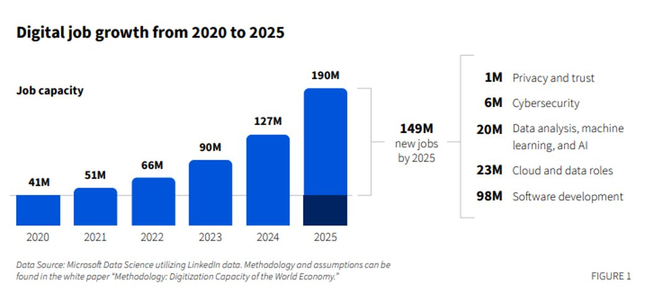

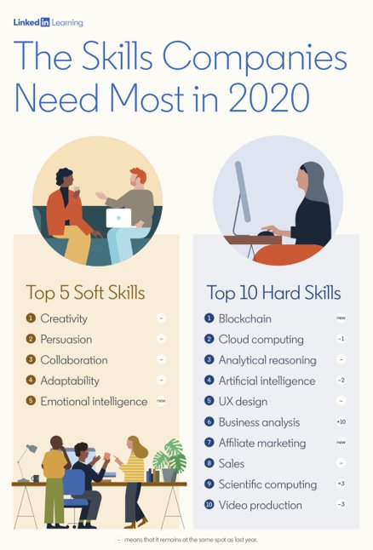
Disclaimer
This course is a 2-SCU course
BUT, :

Slide 3

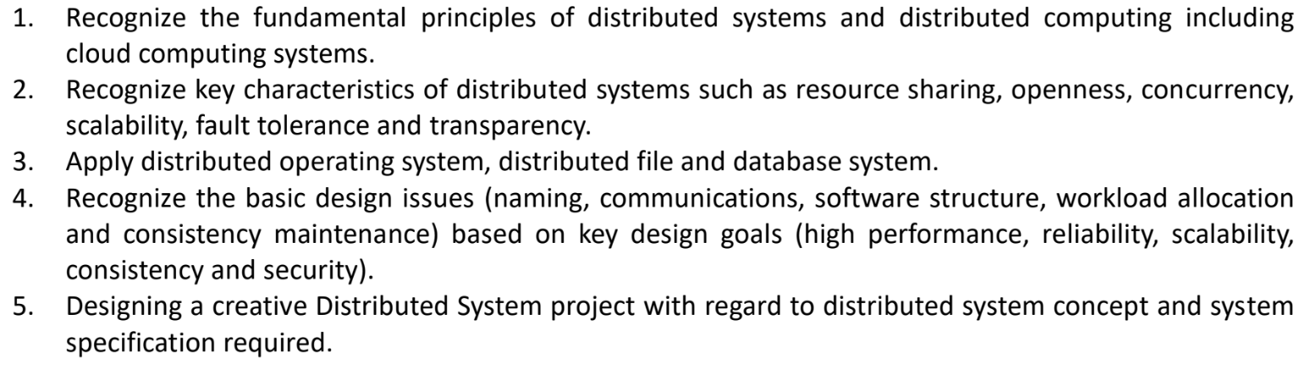

Learning Outcomes
What do you want to learn from this class?
https://ideaflip.com/b/9bzzc2gp8hrd/

Slide 4
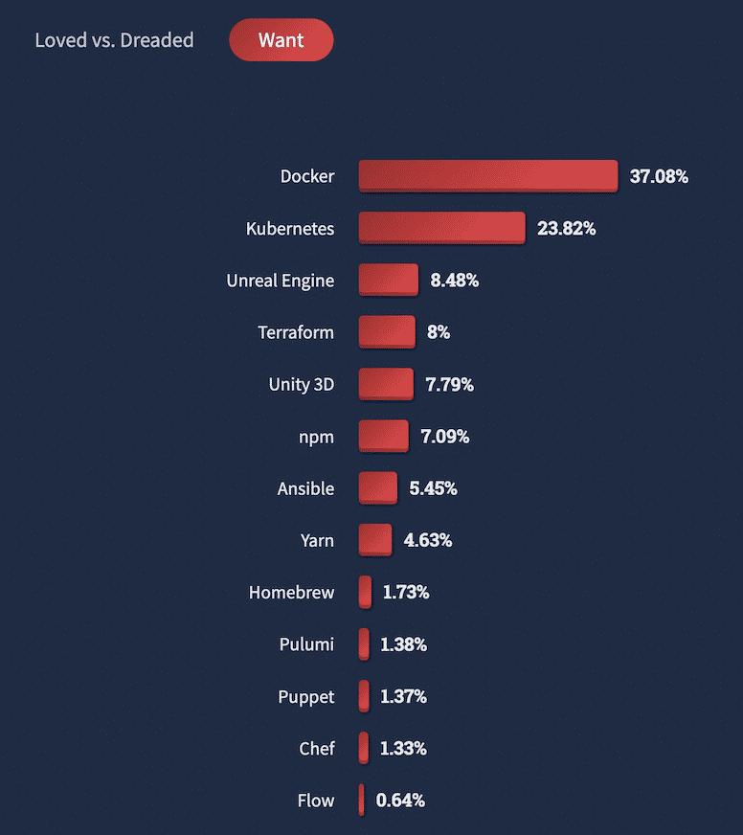
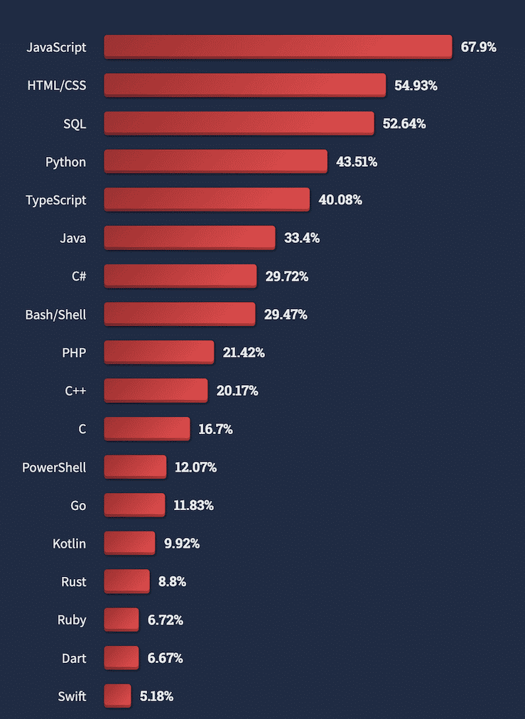
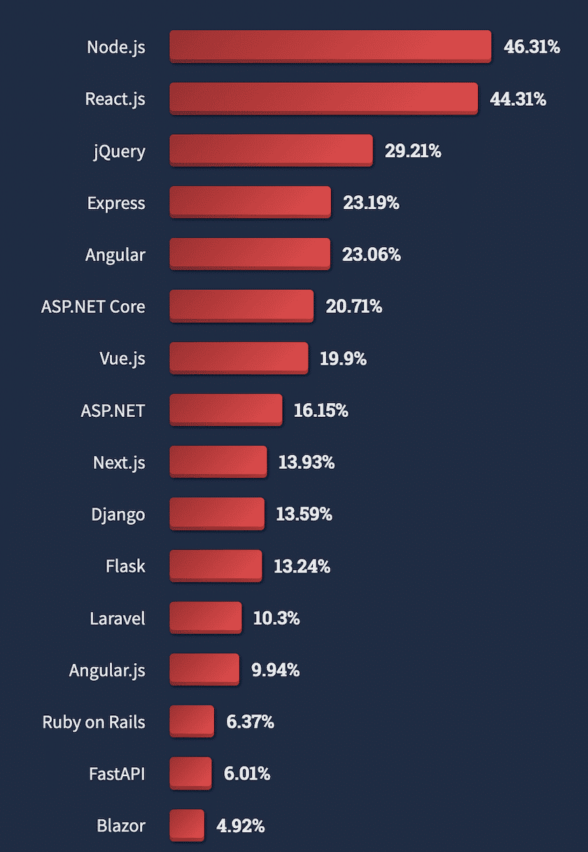

Slide 5

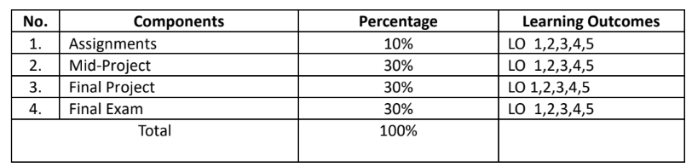


Rubrics
60%
minor
Please register here now!

Slide 6
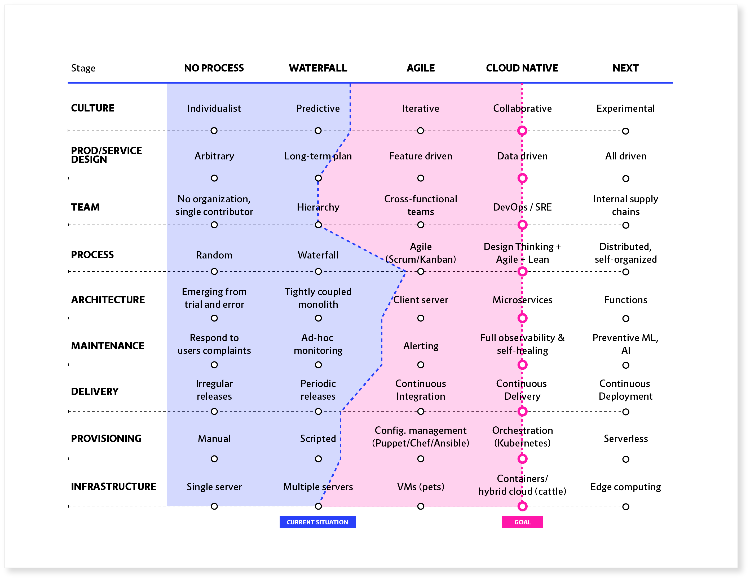
Final Project
Only one project will be developed for each class
Microservice architecture
Cloud Native
I WANT YOU TO READ at least A TEXTBOOK FOR THIS CLASS!!
Start by finishing (and understanding) the 1st and 2nd chapters of “Microservices Patterns” by CHRIS RICHARDSON before next week.

Slide 7
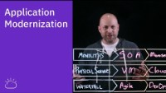
Let’s watch https://www.youtube.com/watch?v=RJ3UQSxwGFY

Slide 8
NEXT WEEK
We’ll agree on a project requirement (should be a web app)
You’ll try to organize a team comprising all students in your class (just imagine that you start a company with all your classmates :D)
You’ll try to architect the app-to-be-develop using a microservice architecture based on Richardson’s book

Slide 9


